Slide 1
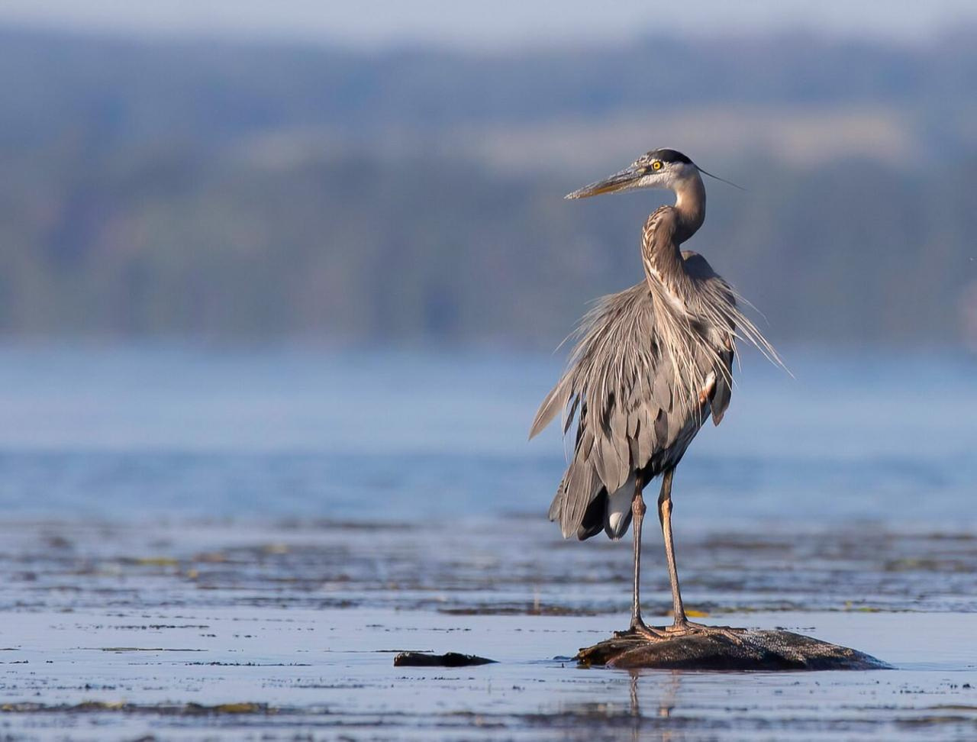
EXTRACTING RELEVANT RECORDS FROM TWO LARGE COLONIAL WATERBIRD DATASETS​

Slide 2
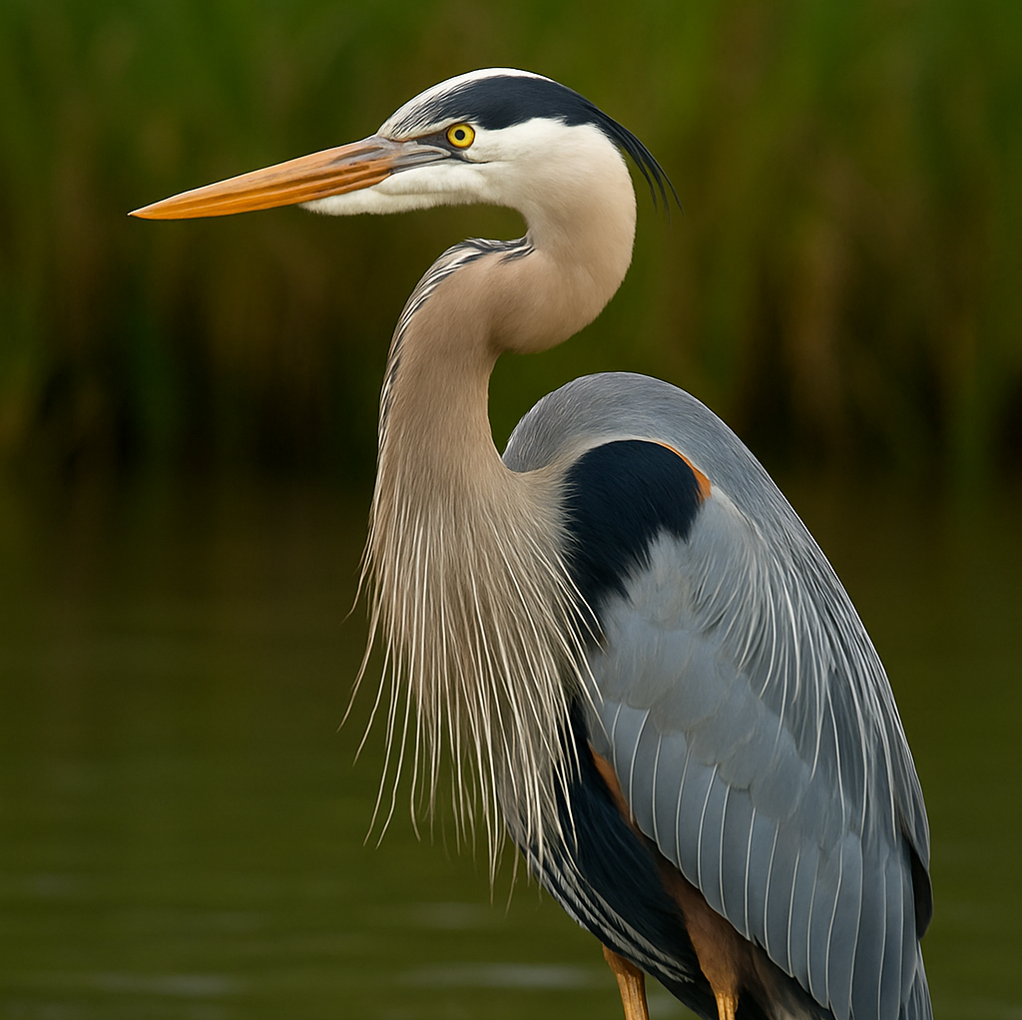
Why 'Blue Heron'?
Named after one of the colonial waterbird species in our dataset.
Represents resilience, adaptability, and precision — values reflected in our project.
Connects our team identity to the species represented in the data we cleaned.

Slide 3

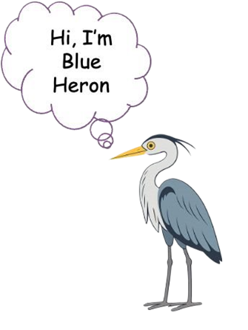



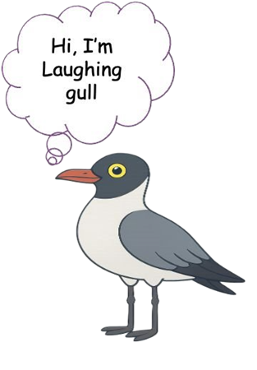



Meet Our Team Blue Heron
Gauri Tiwari
Sandeep Lingampelly
Puneeth Velivela
Product Owner
Scrum Master
Developer
Shreya Rajani Shankar
Rahul Guttapally
Vivek Patil Paidigumal
Developer
Developer
Developer

Slide 4

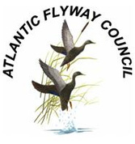
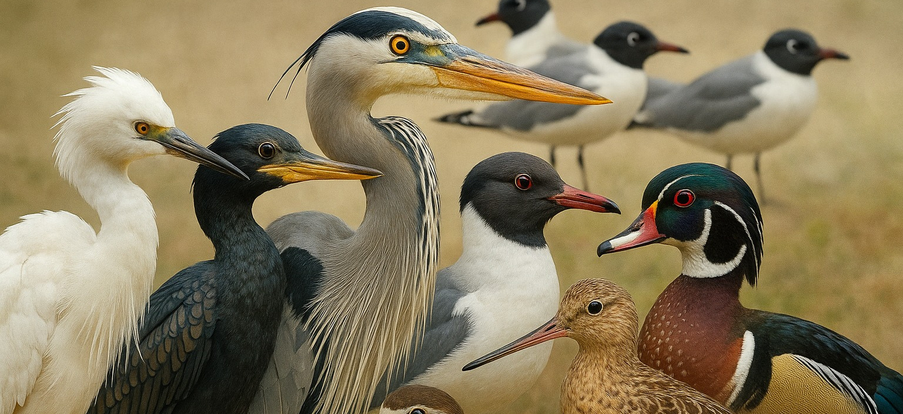

The Atlantic Flyway Council (AFC) Nongame Migratory Bird Technical Section (NMBTS)​
Who They Are
What They Do
Why It Matters
Nongame Migratory Bird Technical Section (NMBTS) is a working group under the Atlantic Flyway Council focused on conserving non-hunted migratory bird species.​
They lead multi-state coordination of bird population surveys, compiling long-term data critical for tracking species like colonial water birds.
Their insights directly support evidence-based conservation policies and habitat management across the Atlantic Flyway region.

Slide 5


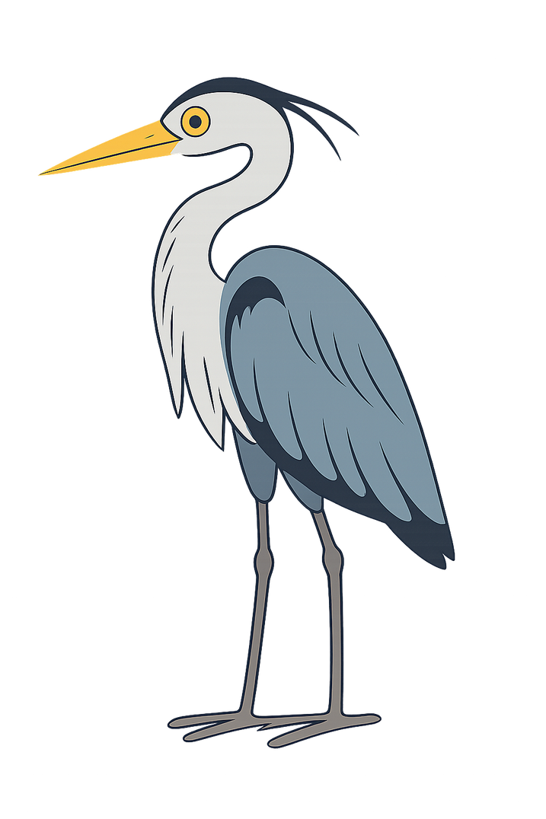
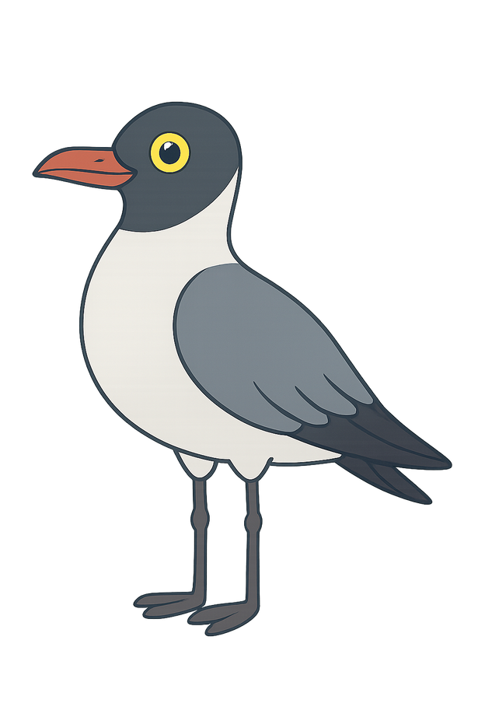
Problem Statement
You ever wonder why researchers still can’t track us properly after all these years?
Pfft. Every state’s got its own way of writing things down.
Last week I was listed as a pelican from Ohio!
It’s time they clean the clutter—for our sake, and theirs
Data formats differ, species codes are outdated, and sometimes the metadata’s… well, missing.
“When data's a mess, even the birds notice. Consistent tracking starts with consistent data.”
This project aims to clean and standardize bird survey data across the Atlantic Flyway—ensuring every bird, every record, and every trend counts.

Slide 6
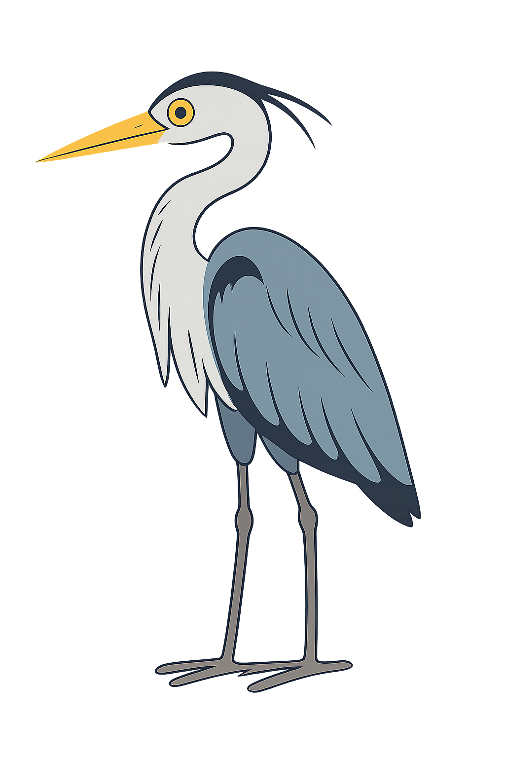





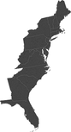
And every row needed cleaning—just like my feathers after nesting season!
The Anatomy of Our Survey Data
Dataset
Data quality Challenges
02
Rows: 67,049
Fields: 50
Type:Colonial Waterbird survey records
Time Range: 1850-2019
Survey Region: Atlantic Flyway states
Standardized formats for dates, species names, and count units
Removed redundant or irrelevant fields to simplify the dataset
Main Data Components
Survey Details: Date, Time, Observer, Visit Number
Geographical Data: Colony Name, Latitude, Longitude, County, State
Species Data: Species Name, Count Type, Population Estimate
01
03

Slide 7
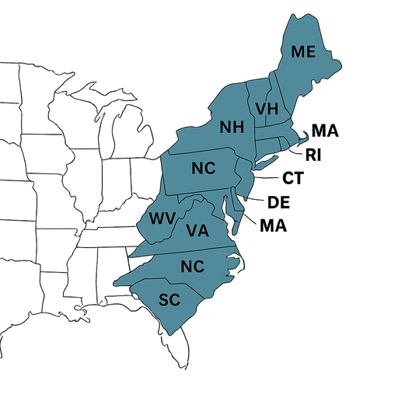
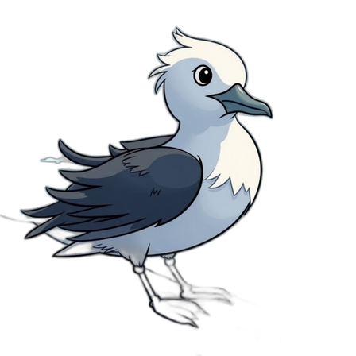
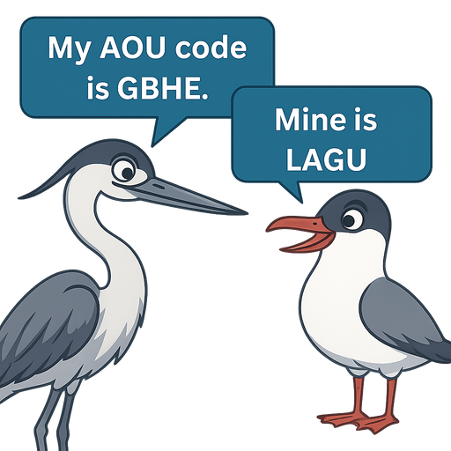
Supporting Datasets
Atlantic Flyway States List
Colonial Waterbird List
AOS Species Code List
Purpose: Geographic filter
Confirmed records from valid Flyway states & provinces
Excluded non-relevant locations like AZ, CO, ID
Purpose: Filter bird species
Removed species not aligned with the project scope
Purpose: Standardize and validate species names & codes
Mapped 4-letter AOU codes to full species names

Slide 8
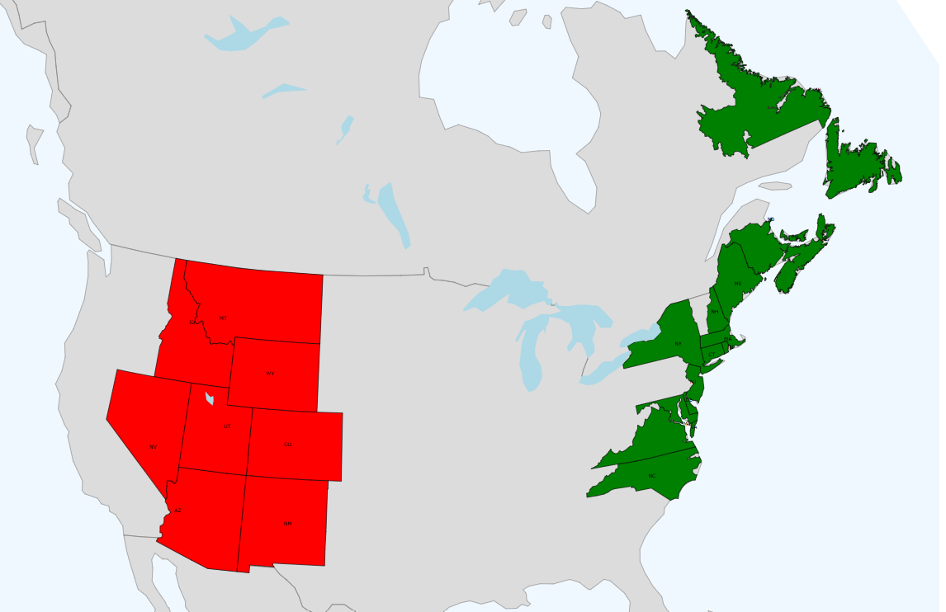
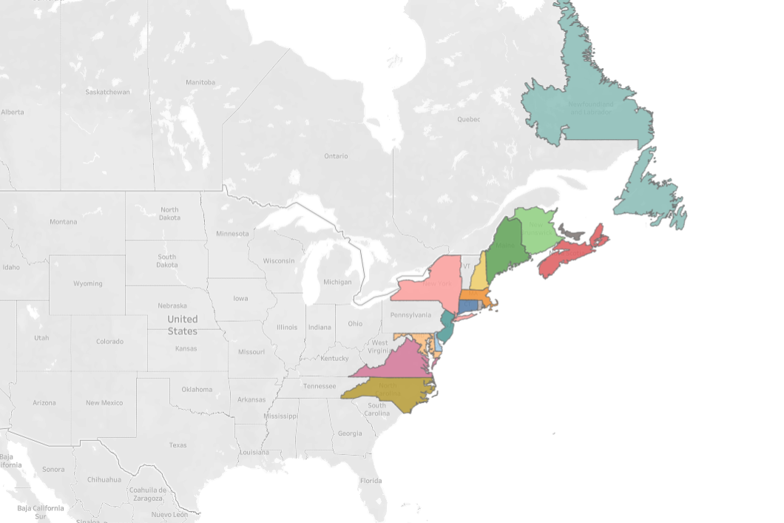
Geographic Cleanup:
Focusing on the Atlantic Flyway
Raw Dataset View
Rows with missing state names were filled using their GPS coordinates.
Irrelevant records outside the Atlantic Flyway were filtered out to maintain ecological focus.
Two datasets were preserved — one with valid Flyway records and another with excluded entries.
This cleanup ensured complete, region-specific data for accurate conservation analysis.
Flyway Dataset View

Slide 9
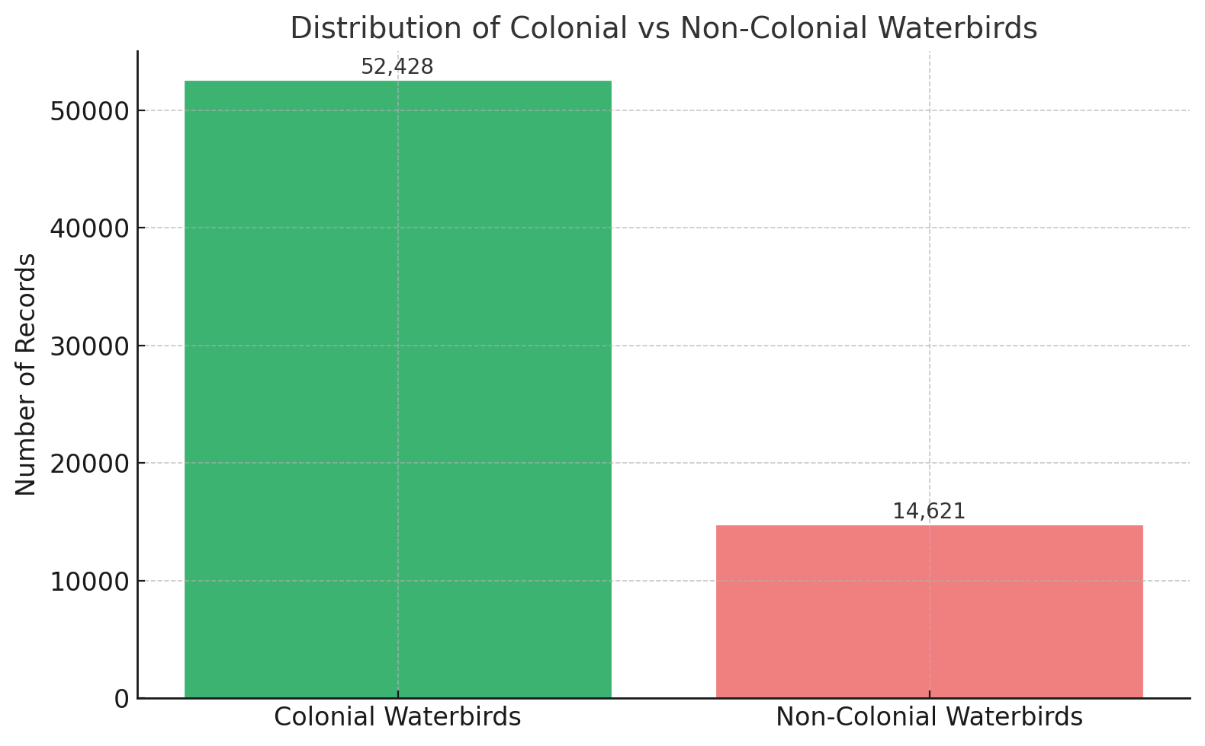
Filtering Out Non-Colonial Waterbird Species
Identified species which are non-colonial water birds.
Cross-referenced all species against the official target list provided by the partner.
Retained only relevant species records to ensure dataset accuracy and relevance.
From code soup to clean species stew—delicious

Slide 10
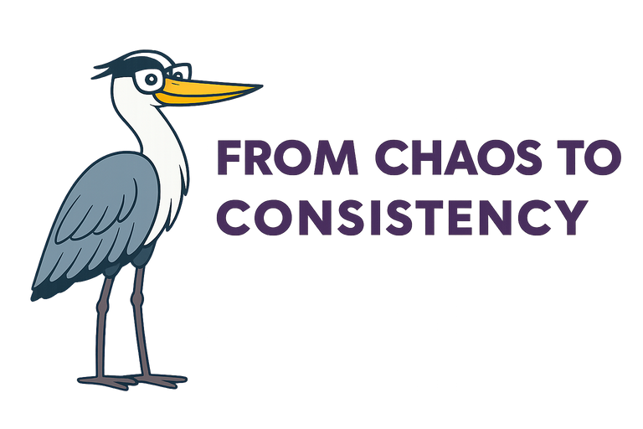
Column Standardization
Column Standardization
Messy Values
Column
Cleaned Values
nests, Yg Fledged, Nest
UnitCounted
Nests, Fledged Young
ground, foot, ground/boat
SurveyMethod
GROUND, BOAT
Partial, Part Count, estimate
CountType
Partial, Estimate
“1,098 variants of messy raw inputs across 5 fields Standardized to 464 validated values across fields.”

Slide 11
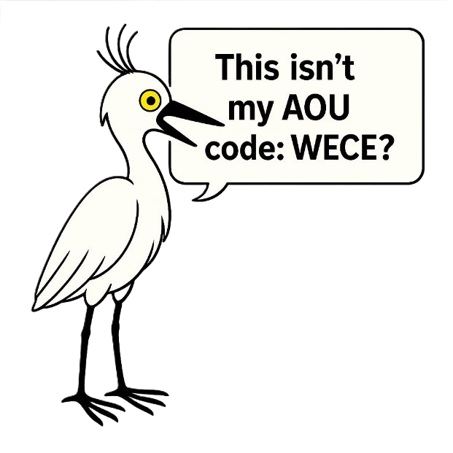
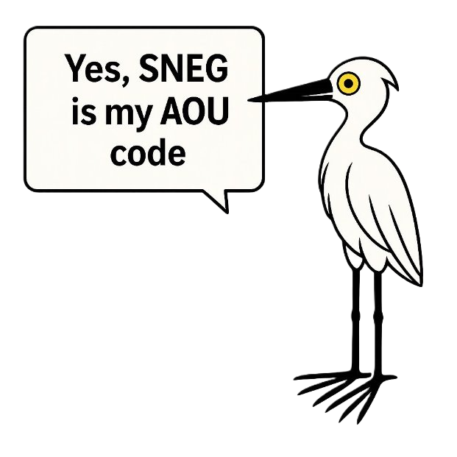
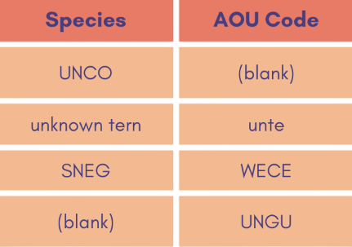
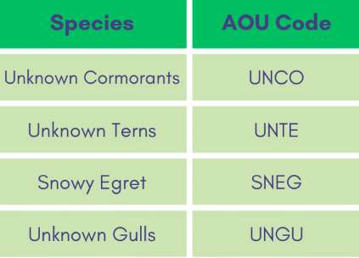
Bridging Outdated Codes to Modern Taxonomy
Raw Data
Cleaned Data
“Cleaned over 30 inconsistent species identifiers across legacy AOU codes and names — standardizing them into 100% validated, taxonomy-aligned records”

Slide 12
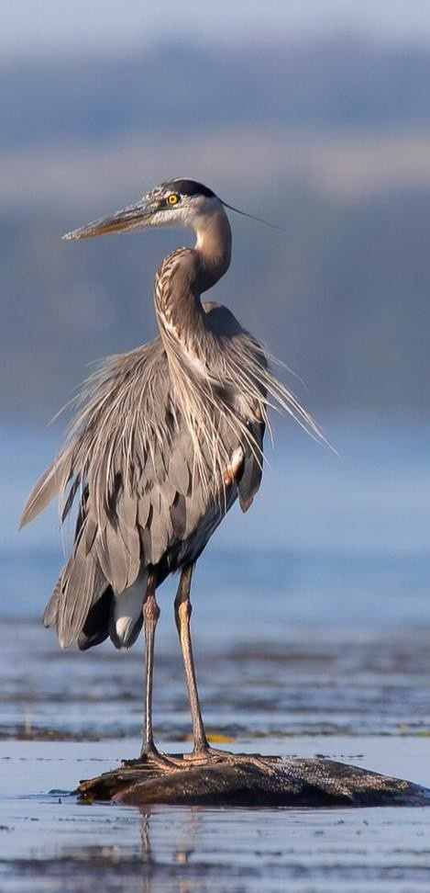




Small Fixes, Big Impact
Filled population estimate gaps using corrected & uncorrected counts
Restored observer names, removed geographic placeholders
Cleaned noise from encoding errors (e.g., “Ã‚”, “nown”)
Moved landmass values from Observer to dedicated column

Slide 13
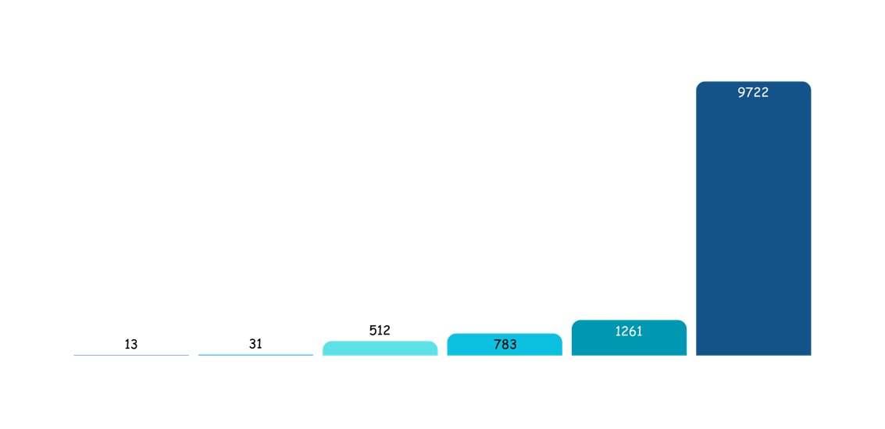


Making Uncertainty Visible
Key Flagging Triggers
1
Vague terms like “Adults”, “Individuals”, or “Fledged Young”
2
Missing or "Unknown" Unit Counted
3
Surveys in Non-Breeding Months
4
Blank Population Estimates

Slide 14
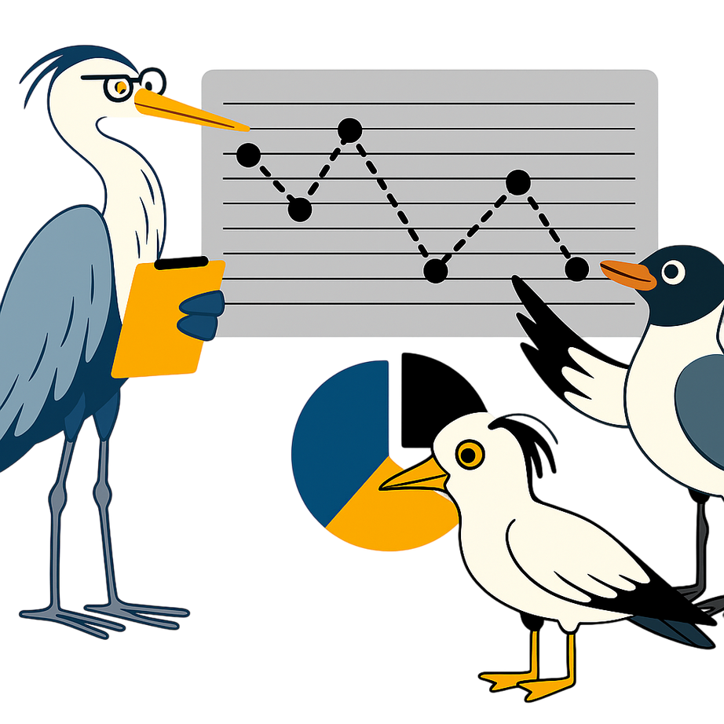
Dashboard Data Preparation
Dashboard Data Preparation
Nest-to-Individual Conversion
Nest-based counts were multiplied by 2 to align with individual-level population estimates
Removing Redundant Records
Only the most reliable entry per month, state, and species was kept to avoid repeated values.

Slide 15
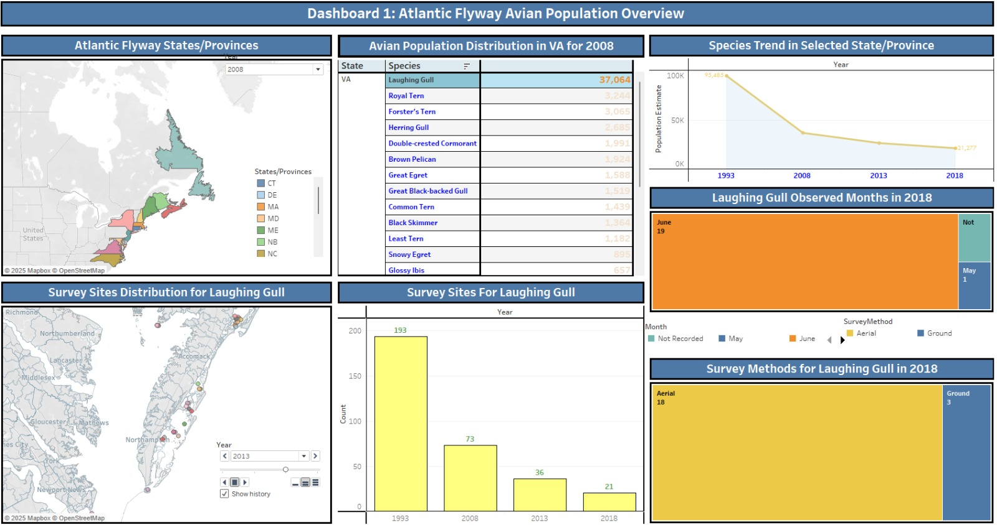

Slide 16
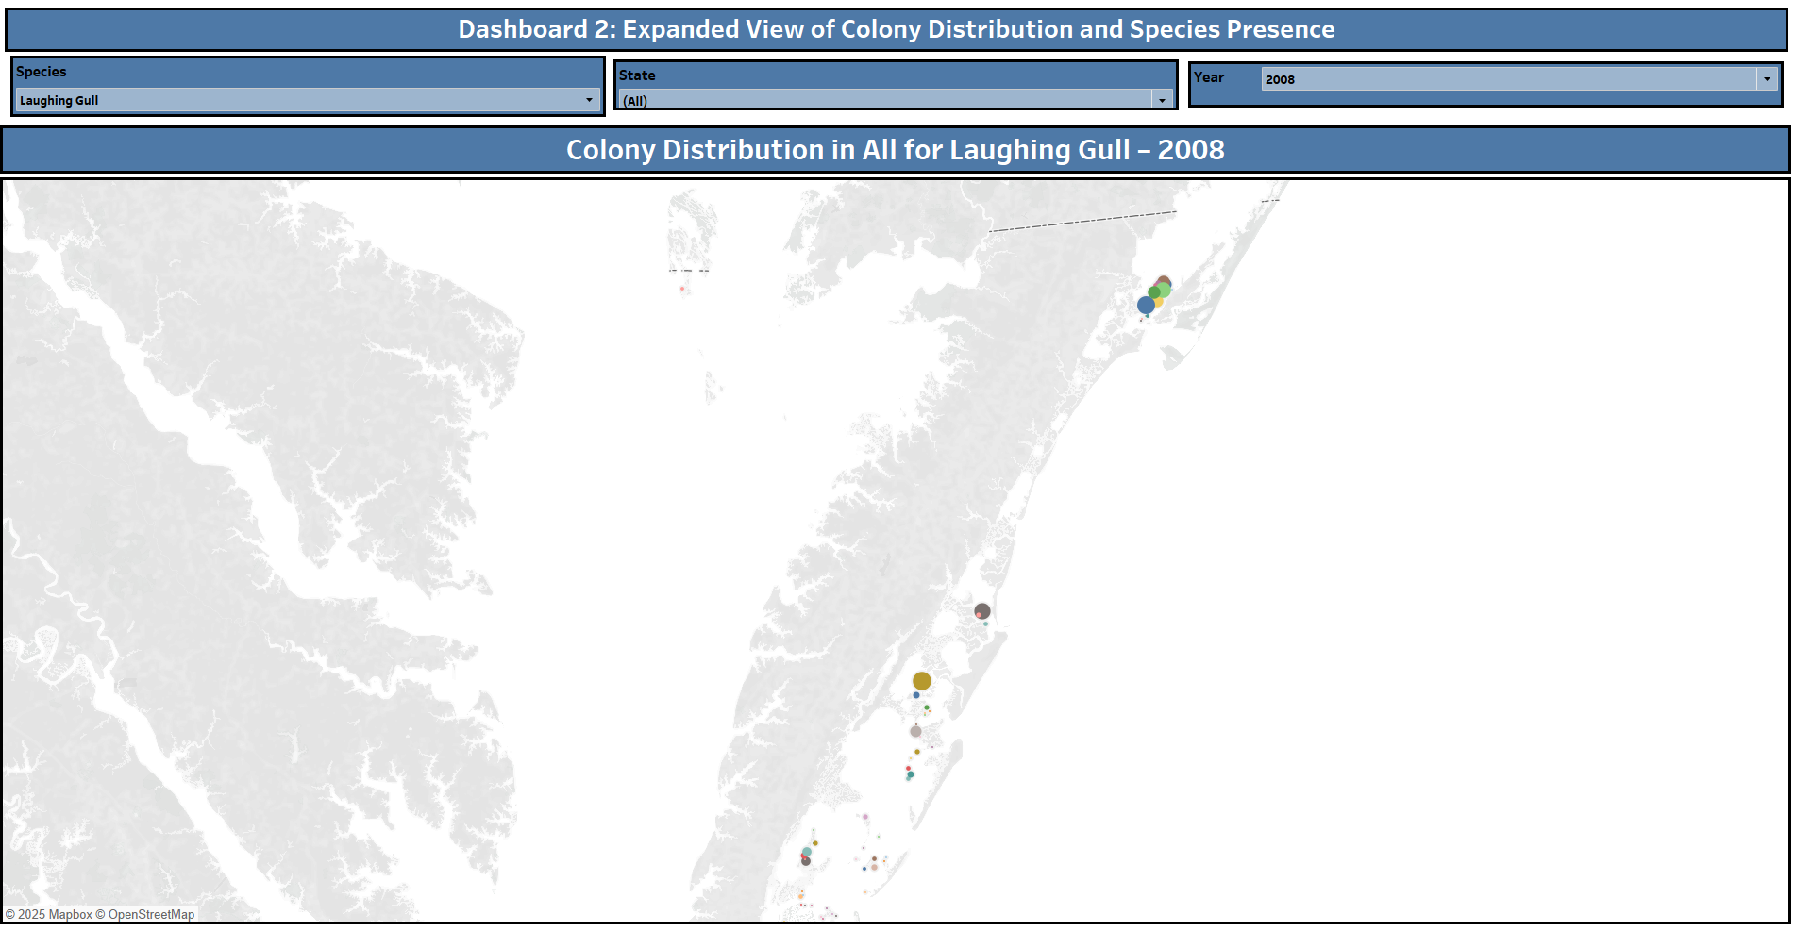

Slide 17
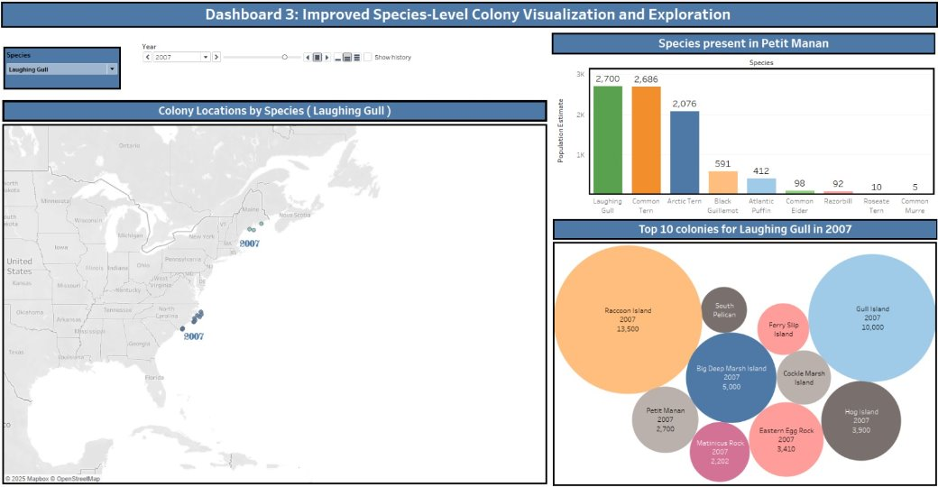

Slide 18






Summary
01
02
03
04
05
Standardized and cleaned historical colonial waterbird data across Atlantic Flyway states.
Resolved missing, inconsistent, and outdated entries to improve data accuracy.
Flagged and documented records for biologist review using structured criteria.
Developed two interactive Tableau dashboards to explore population trends and colony-level insights.
Outputs support data-driven conservation efforts and guide future survey enhancements.

Slide 19
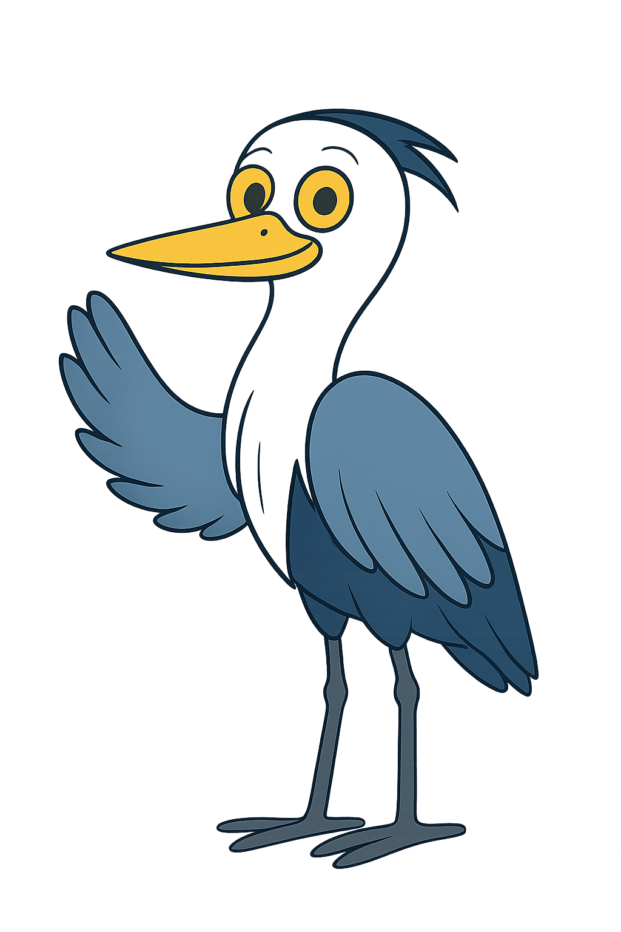
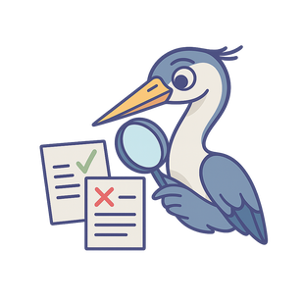




Let’s stretch those wings and gracefully glide into… whatever’s next!"
Next Steps
Expert Collaboration
Data Integration
Trend Analysis
Strategic Management
Sustainable Framework
Work with state experts to resolve flagged records and remove unverifiable data
Combine cleaned historical data with the 2023–2024 Colonial Waterbird Survey results
Investigate population trends and changes across Flyway-wide, regional, and local scales
Apply insights to improve conservation of CWB species and their ecological interactions
Ensure the system remains scalable and adaptable for long-term monitoring and planning

Slide 20
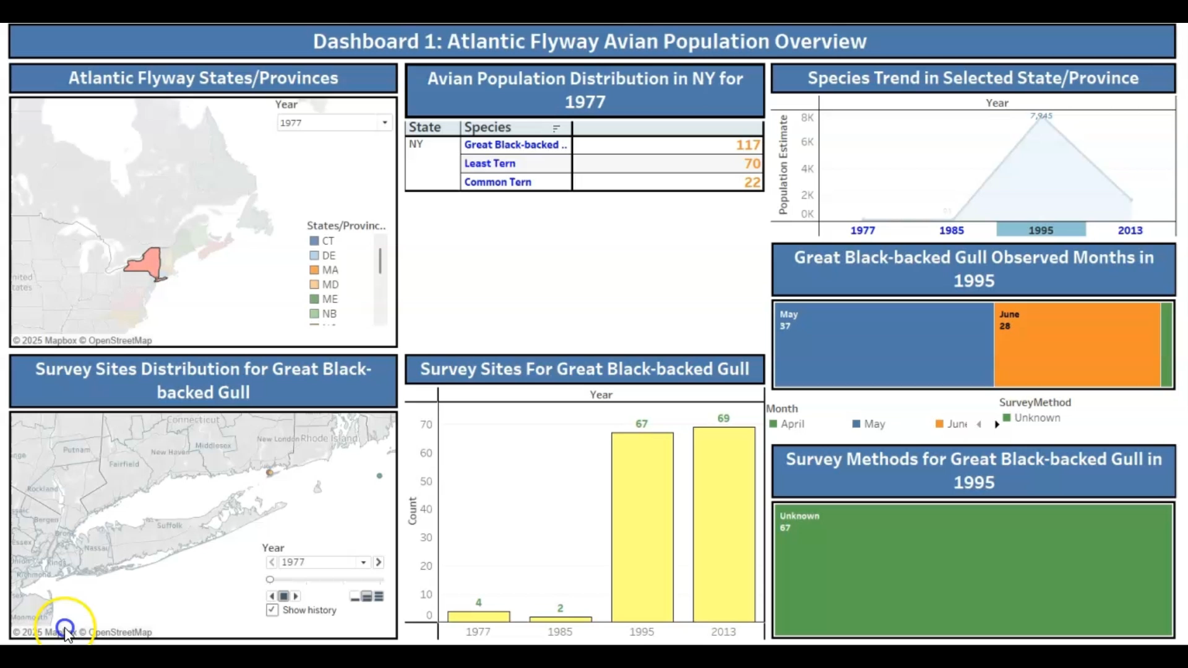

Slide 21

QUESTions

